Slide 1


Wind Turbine- Anomaly Prediction DSC630- Predictive Analytics Amit Saxena
Final Project Presentation
Notes:
Hello, my name is Amit Saxena. I’m a Marine Engineer working with SAP as an Architect for Intelligent Asset Management.
As part of the final project presentation in D S C 630 Predictive Analytics, I'm going to present my project’s objective, data used, models I tried and my conclusion in this video presentation.
My goal is to test and recommend an efficient anomaly prediction model.

Slide 2

Introduction
The goal of my project is to:
Build an anomaly detection model to predict wind turbine malfunctions with accuracy
Avoiding unplanned wind turbine breakdown
Increase uptime of the wind turbine
Reduce maintenance costs
Anomaly detection is a process in machine learning that identifies data points, events, and observations that deviate from a data set’s normal behavior. And, detecting anomalies from time series data is a pain point that is critical to address for industrial applications. ^{[1]}
Notes:
I’ll begin with an introduction and explain my goal for the project which is to build an Anomaly detection model using existing methods such as Isolation Forest and One Class SVM.
Ever since IoT or ‘internet of things’ is being used in machines to collect data, we have more data than we can use. Interpreting this huge amount of data manually is not feasible and we have to look at Artificial Intelligence and Machine Learning to interpret it for us, so that we can track trends and patterns in the data.
Anomaly detection, also known as outlier detection, is a process in machine learning that identifies data points, events, and observations that deviate from a data set’s normal behavior.
Using these trends, we can predict anomalies and therefore take corrective actions to address those anomalies.
Anomaly Detection is a technique of identifying rare events or observations which can raise suspicions by being statistically different from the rest of the observations. Such “anomalous” behavior typically translates to some kind of a problem like a credit card fraud or a failing machine.

Slide 3
Objective
Benefits I expect from the project are:
Reduced unplanned machinery breakdown
Efficient execution of maintenance tasks
Reduced maintenance cost
Better planning of manpower/ resources and spare parts/ materials
Reduced downtime
I want to achieve this using Anomaly Detection model:
Prepare the data
Train the data using training dataset
Try 4 different Anomaly Detection models
Check the results using test dataset
Propose the best performing model as the outcome of the project
Notes:
As mentioned earlier I’m a marine engineer, I’ve worked hands on in maintenance and I’m passionate about machines. Currently I work in Asset Intensive industries focusing on SAP implementations on designing and building maintenance processes and solutions. I can see how valuable AI and ML can be in improving maintenance processes.
Therefore, my objective in this project is to use anomaly detection on data collected from sensors on machines.
Assets that can benefit with this model are Equipment used in power generation, oil and gas, mining, or manufacturing such as a wind turbines, gear boxes, compressors, and pumps etc.
The benefits of anomaly detection in maintenance industry are-
Reduced monitoring and troubleshooting by having ML do it for us.
Ability to define predictive maintenance programs utilizing rules and alerts built on anomaly detection.
Reduced maintenance costs
Prevention of unplanned failures, and
Reduced downtime
For the project I started with data preparation, then I split the data into training and test sets. I tried 2 different models with 2 variations each using the training dataset.
I checked the results of these 4 models and then decided which model performed best, which I proposed as the outcome of the project.

Slide 4

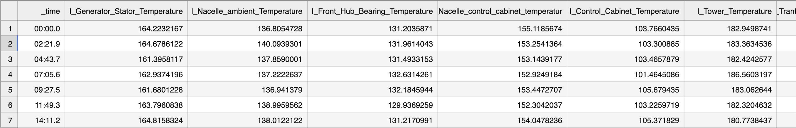
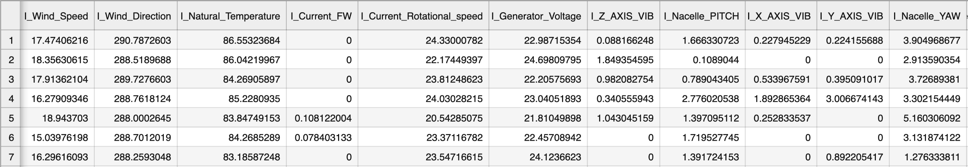
Data
I used IOT Data of a Wind Turbine from Kaggle
Data contains information of:
Temperature
Voltage
Rotational Speed
Vibration
Power Output
Yaw
Components of the wind turbine:
Generator
Nacelle
Control cabinet
Tower
Transformer
Rear and Front Hub Bearing
Notes:
The dataset I used is from Kaggle and is IoT data on Wind Turbines. The data has readings of temperature, vibration, yaw, power output, speed and voltage. The parts of turbine from which we collected the sensor readings are the generator, nacelle, control cabinet, tower, transformer and hub bearings.
This is time series data and is expected to be within certain limits. If this data is going beyond the normal range, then it should be caught by the model as anomalous data. I tried to create line charts with these time series data, but it was not possible for me to identify any anomalies manually without the help of machine learning. So, I removed those charts from the project.

Slide 5

Prediction Model
I created 4 models- 2 for Isolation Forest and 2 for One-Class SVM, with combinations of hyperparameters.
Model 1- Anomaly Detection with Isolation Forest
Model 2- Anomaly detection with Isolation Forest with scores
Model 3- Anomaly Detection with One-Class SVM (Hyperparameters- kernel='rbf', gamma=0.001, nu=0.01)
Model 4- Anomaly Detection with One-Class SVM (Hyperparameters- kernel= 'rbf', gamma= 'auto', nu= 0.01)
Hyper-parameters for SVM:
nu: Controls the proportion of outliers allowed
kernel: Determines the type of decision boundary. I used ‘rbf’ kernel as it can effectively capture complex non-linear relationships
gamma: Parameter for non-linear hyperplanes, specific to the RBF kernel
Notes:
I tried 4 different models- 2 on isolation forest and 2 on one-class SVM with different parameters.
Isolation forest- is an efficient anomaly detection technique. It constructs a set of binary trees called Isolation Trees by randomly selecting features and recursively splitting data points. Anomalies, being rare, are easier to isolate and have shorter paths in the trees, while normal data points require more splits, resulting in longer paths. By measuring the average path length, the algorithm identifies anomalies as data points with shorter paths, falling below a predefined threshold. Isolation Forest is highly effective for detecting outliers, especially in high-dimensional data, making it valuable for applications like fraud detection and network security.
The One-Class Support Vector Machine or (SVM) is a variant of the traditional SVM. It is specifically tailored to detect anomalies. Its primary aim is to locate instances that notably deviate from the standard. Unlike conventional Machine Learning models focused on binary or multiclass classification, the one-class SVM specializes in outlier or novelty detection within datasets.
Anomaly detection is generally of 2 types- supervised and unsupervised.
Supervised Anomaly Detection requires a labeled dataset containing both normal and anomalous samples to construct a predictive model to classify future data points. The most commonly used algorithms for this purpose are supervised Neural Networks, Support Vector Machine learning and K-Nearest Neighbors Classifier among others.
Unsupervised Anomaly Detection does not require any training data and instead assumes two things about the data that Only a small percentage of data is anomalous, and Any anomaly is statistically different from the normal samples. Based on the above assumptions, the data is then clustered using a similarity measure and the data points which are far off from the cluster are considered to be anomalies.

Slide 6

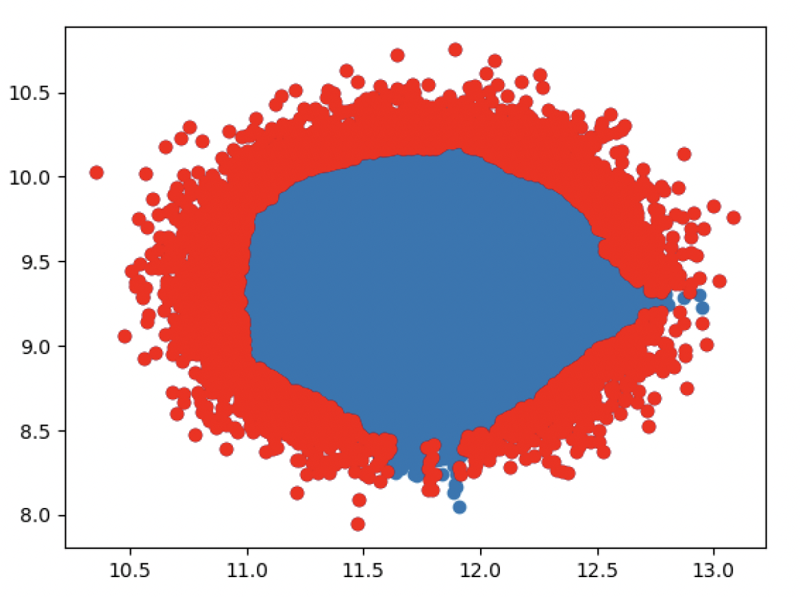
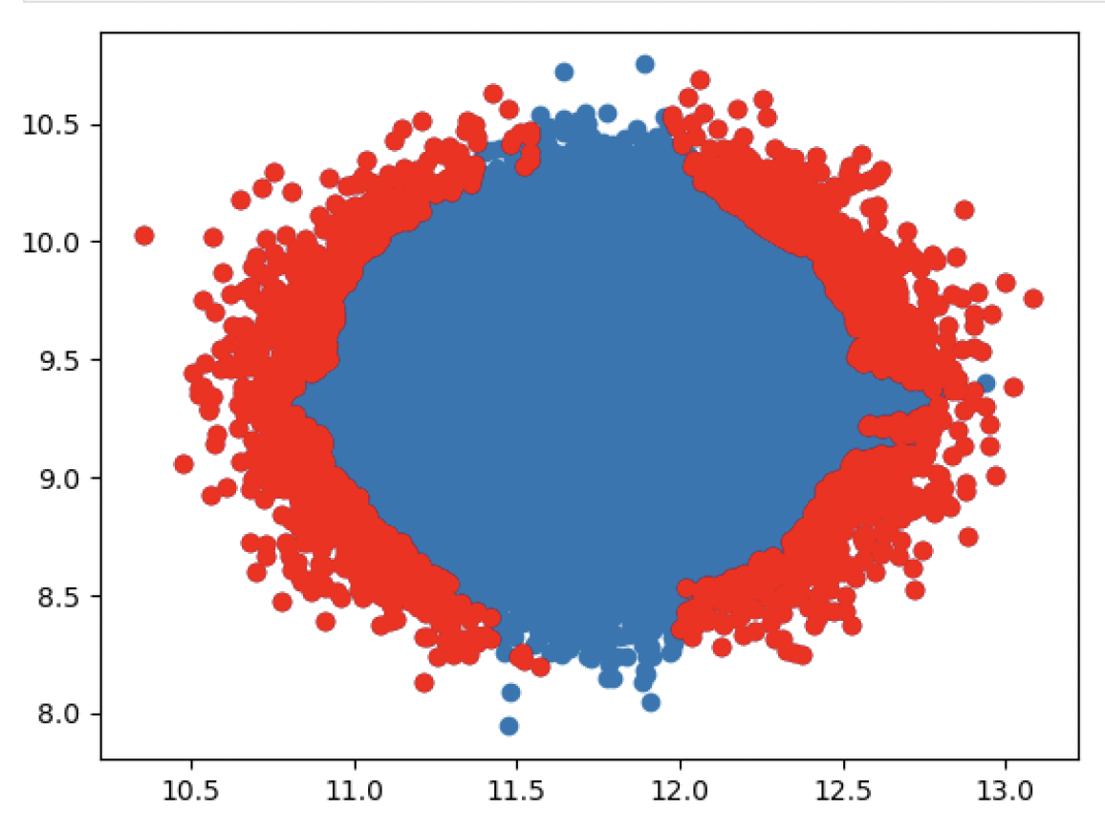
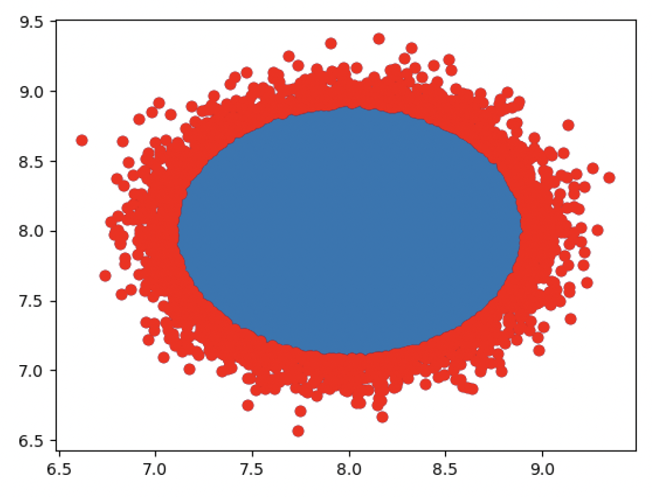
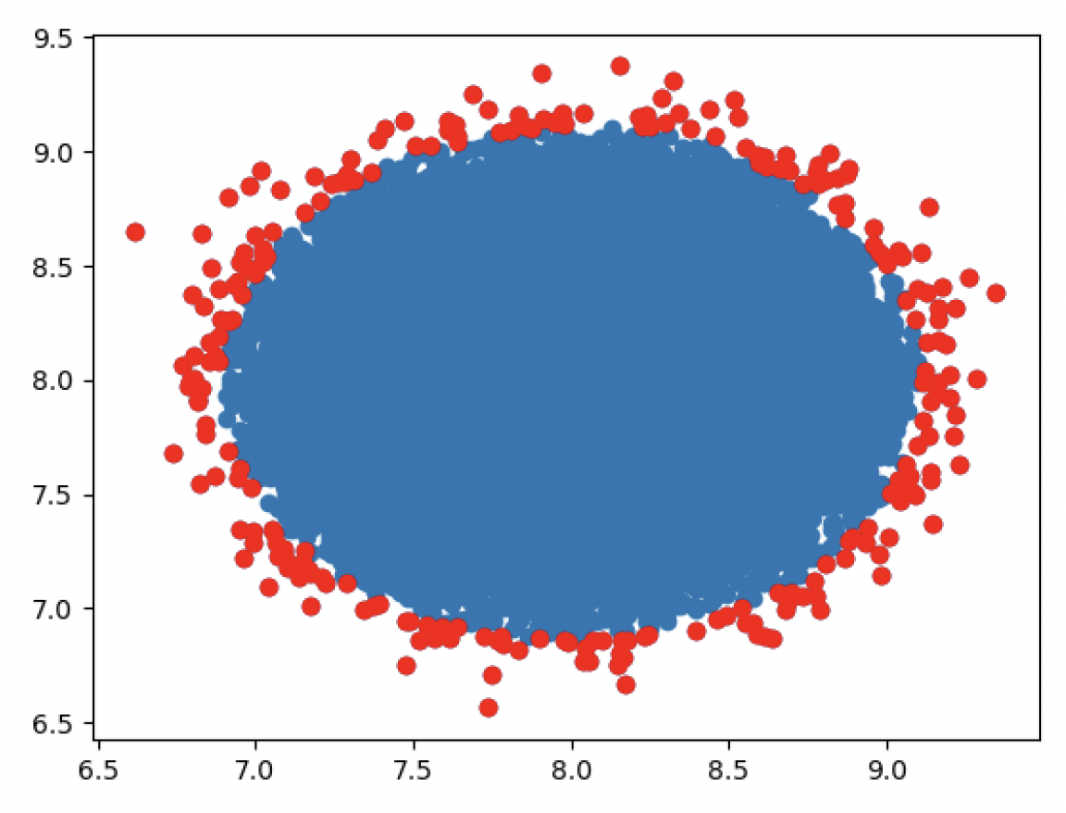
Visualization
Model 1- Anomaly Detection with Isolation Forest:
Model 2- Anomaly detection with Isolation Forest with scores:
Isolation Forest
Model 3- Anomaly Detection with One-Class SVM (Hyperparameters- kernel= 'rbf', gamma=0.001, nu=0.01 ):
Model 4- Anomaly Detection with One-Class SVM (Hyperparameters- kernel= 'rbf', gamma= 'auto', nu= 0.01):
One-Class SVM
Notes:
I used scatterplots for visualization to assess the results of the models.
To assess the accuracy of models and to determine the top-performing model for anomaly prediction, I generated scatterplots based on the results. Since my data didn’t have labels and the model was unsupervised, I couldn’t rely on accuracy metrics alone. I had no way to check that.
Instead, I used visualizations to identify anomalies. I plotted the anomalies in different color than the rest of the data. The plots then allowed me to visually evaluate the performance of various models and their parameter variations in detecting outliers.
As you can see in the scatterplots on this slide, the results of model 1 and 2 were not very impressive as the no. of outliers was high and I felt it was not accurate as well. Model 3 on one class SVM performed better in terms of consistency in finding the outliers, but the count of anomalies was very high.
My 4th model on one-class SVM with different hyperparameters than the 3rd model performed really well in my opinion. The anomalies were consistent in nature, and the count of anomalies was also low.

Slide 7
Performance
One-Class SVM performed better than Isolation Forest.
Model 4- Anomaly Detection with One-Class SVM (Hyperparameters- kernel= 'rbf', gamma= 'auto', nu= 0.01) performed best with my data.
Since the data was unlabeled, I relied on scatterplots to ascertain which model is performing best.
Notes:
As we saw in the previous slide, I found that the 4th model created using the One-Class SVM, is the best-performing model for this project.
For this model I had chosen nu, ‘which Controls the proportion of outliers allowed’, as 0.01 which means 1%, and the kernel, which Determines the type of decision boundary as ‘rbf’- radial basis function also called as gaussian kernel, so that it may effectively capture complex non-linear relationships. I kept gamma as ‘auto’.
Again, I thought this was the best model as per the scatterplot.

Slide 8

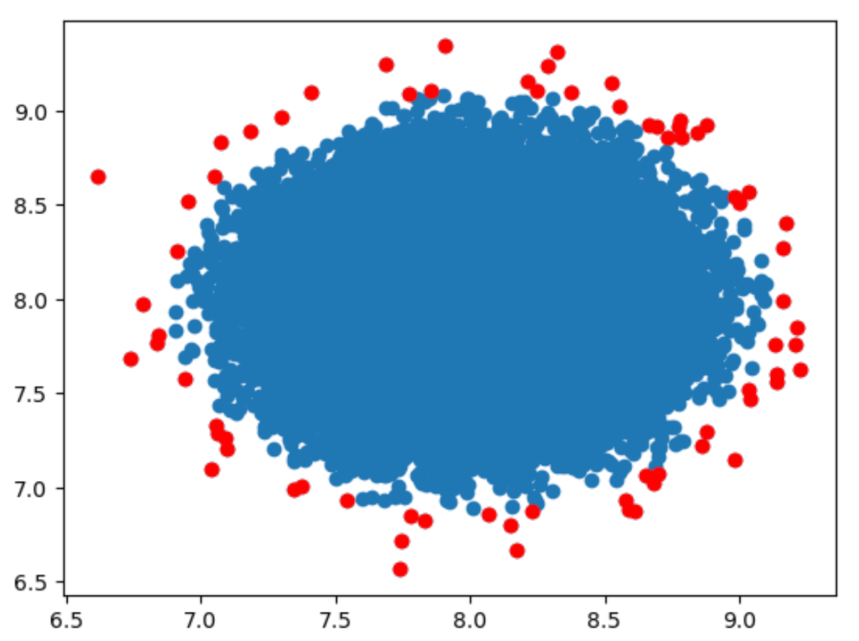
Validation Using Test Data
After I finalized model 4 as the preferred way for anomaly detection I tried my test dataset.
The performance of the 4th model was acceptable with the test dataset as well.
Model 4- Performance Test
Test Dataset
Notes:
Once I had seen that the 4th model was performing best in anomaly detection, I went on to check it on the test dataset. Although the test data is not labeled, I still wanted to see the scatterplot to get an idea of the anomalies found in the test data.
As you can see, the scatterplot is uniform and the anomalies are at or outside the border. The no. of anomalies also are justifiable.
I am quite satisfied with the results and it reaffirms my decision to recommend 4th model as the preferred model for anomaly detection.

Slide 9

Ethical Considerations
Ensuring that the data being used doesn’t contain any personally identifiable information (PII) or a company’s restricted data.
Provide references to the data and sources I’ve used in the project to give credit to the authors for those articles.
The data and the results should also be scrutinized to make sure there is no bias in the data towards a person or a group of persons, or a particular manufacturer of the machine.
The data should be anonymized to ensure it doesn’t contain any kind of identifiers for the manufacturer, operator or the owner of the machine.
Notes:
Here are some ethical considerations I kept in mind while working on the data.
I ensured the data doesn’t contain any company confidential information and that the results do not have any bias towards a particular manufacturer.
The data should also be anonymous so as not to contain anything in it which could identify the manufacturer, operator or owner of the equipment. Trademark data from the owners about their maintenance strategy etc. should be protected so that they keep their competitive edge from their competitors

Slide 10

Conclusion
One-Class Support Vector Machine (SVM), a variant of the traditional SVM and is specifically tailored to detect anomalies is the best performing Anomaly Prediction model.
One-class SVM specializes in outlier or novelty detection within datasets.
I recommend defining alerts whenever an anomaly is detected in the data.
When an anomaly occurs, with the help of alerts it could be further investigated, and corrective actions taken.
Notes:
To conclude my project, I recommend constructing a One-Class SVM model, with parameters chosen in the 4th model, for anomaly detection and setting up alerts based on it. Whenever an anomaly is detected in the data, an alert should be triggered, which should be followed with further investigation and corrective actions, if needed.
As part of continuous improvement, the model should be fine tuned and tailored on actual data from machine sensors and efforts should be made to reduce false negatives and false positives.
Over time once the model is sufficiently accurate, it should be deployed in a productive environment so that actual malfunctions could be predicted, and predictive maintenance program could be set up.

Slide 11
References
[1]- By Anuradha Bhamidipaty, Dhaval Patel, Shuxin Lin, Srideepika Jayaraman, Giridhar Ganapavarapu, 15 November 2021, What is anomaly detection?
What is anomaly detection? - IBM Developer
Yohanes Nuwara, Version 4 (November 29, 2021). IIOT Data of Wind Turbine. Retrieved March 24, 2024, from Kaggle:
https://www.kaggle.com/code/yohanesnuwara/iiot-wind-turbine-analytics/notebook#1.-Read-data
IIOT Data of Wind Turbine
https://www.kaggle.com/datasets/wasuratme96/iiot-data-of-wind-turbine?resource=download
Fei Tony Liu and Kai Ming Ting, Gippsland School of Information Technology, Monash University, Victoria, Australia; Zhi-Hua Zhou, National Key Laboratory for Novel Software Technology, Nanjing University, Nanjing 210093, China. Isolation Forest. Isolation Forest:
https://cs.nju.edu.cn/zhouzh/zhouzh.files/publication/icdm08b.pdf
Anomaly Detection with Isolation Forest in Python:
https://www.datatechnotes.com/2020/03/anomaly-detection-with-isolation-forest-in-python.html
A Comprehensive Guide for SVM One-Class Classifier for Anomaly Detection
https://www.analyticsvidhya.com/blog/2024/03/one-class-svm-for-anomaly-detection/
Anomaly Detection with Isolation Forest in Python
https://www.datatechnotes.com/2020/03/anomaly-detection-with-isolation-forest-in-python.html
Machine Learning for Anomaly Detection, 03 May 2023
https://www.geeksforgeeks.org/machine-learning-for-anomaly-detection/
Notes:
Here are the links to the data I’ve used in the project and the sources of articles I studied or referenced to create the models.
It also contains the links to the material I used in my narration and presentation.
I really enjoyed working on this project as it gave me an opportunities to think about how I can leverage the knowledge I’m gaining in this program on my actual job.
Thank you very much for your time and I hope I was able to explain my project clearly. Thank you!

